Slide 1
Tips for Parents and Caregivers
By Mrs. Torres

Slide 2
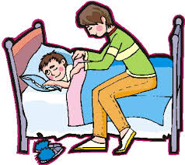
Get plenty of Rest

Slide 3
Designate a quiet place in your house where your child can do homework

Slide 4
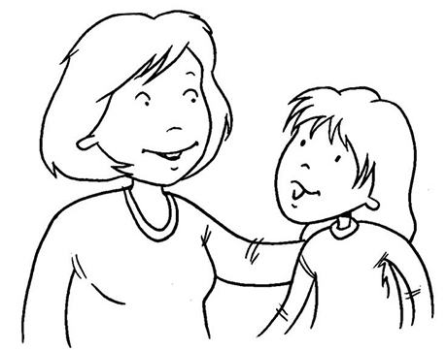
Ask your child what did he/she learn at school

Slide 5
Read to and with your child daily and ask him/her questions about the story

Slide 6
Provide healthy and balanced meals.

Slide 7
Demonstrate and encourage good manners

Slide 8
Pray together !!!

Slide 9
Praise your child!!!

